Slide 1
Life Expectancy
Do humans want to live forever?
Presented by:
Navya Sri Vattikuti
Shiva Rama Krishna Pabba
Venkata Anirudh Doli
Dharshan Govindarajan
MSIS 642 Group 6

Slide 2

Agenda
Introduction
Motivation
Literature Review
Theory and Hypotheses
Data Variables
Data Cleanup
Data Visualization
Models
Results
Conclusion
References

Slide 3
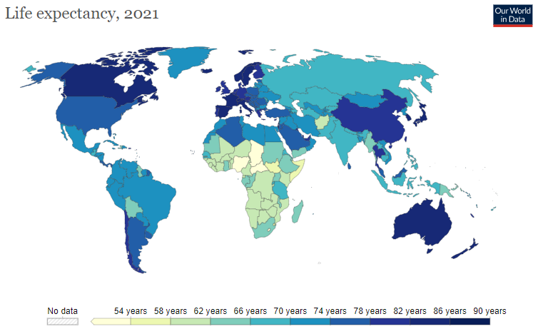
Introduction
People die everyday but a few geographies and periods in history have more people dying at younger ages than other geographies.
What makes people die young or live longer?
Our goal is to pick a few attributes and explore via analysis what changes or how do they impacted the life expectancy across geographies/time period.

Slide 4
Motivation
In some countries the average dying age is about 50 years while in some others it is as high as 85
World bank uses Life expectancy as a major indicator for its evaluation of countries for their development index
There aren’t any analysis available considering all countries and years
What are the major factors for determining Life Expectancy?
By knowing the factors, what suggestions can be given to a country? Can all countries have same Life Expectancy?

Slide 5

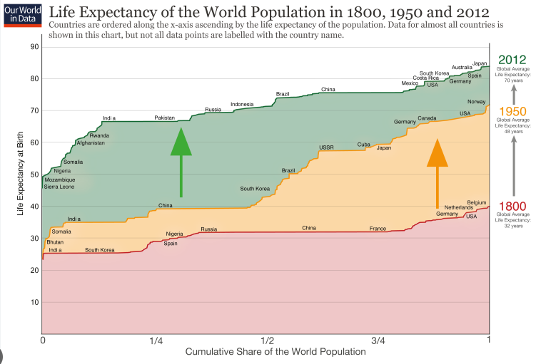
Literature Review
The Global life expectancy has seen an increase by 6 years FROM A MERE 66.8 to 73.4 years in the last 2 decades (Roughly from 2000 to 2019)
Mostly Health care resources play a major role in affecting Life Expectancy
Wealthier countries have a higher average Life Expectancy than poorer countries
Most of the research showed that Life Expectance is majorly affected by the resources available in that country and depends on how they are utilized

Slide 6
Theory and Hypotheses
Hypothesis:
Alcohol Consumption is one of the biggest factors affecting life expectancy
Research Question:
What changes are needed for a country to improve Life Expectancy
H₀: There is no relationship between Life Expectancy and the independent variables
H_{a}: There is a relationship between Life Expectancy and the independent variables

Slide 7
Panel Data
2938 observations & 22 Variables for 193 countries from 2000 to 2015
Status
Under five deaths
Polio
Total Expenditure
Diphtheria
Adult Mortality
Infant Deaths
Alcohol
Expenditure
Hepatitis
Measles
BMI
HIV/AIDS
GDP
Population
Thinness 1-19yrs
Thinness
5-9 years
Income
COR
Schooling
Country
Life Expectancy
Year

Slide 8
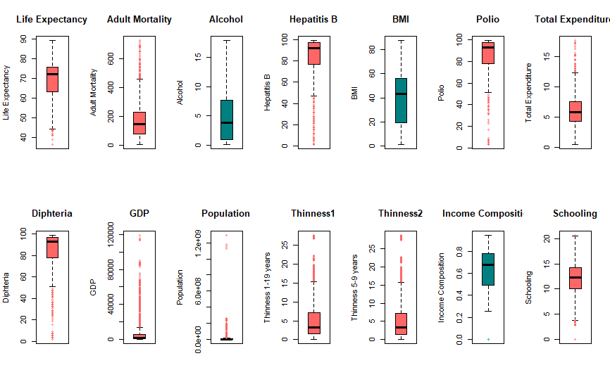
Data Cleanup
These plots show none or few of the outliers in Alcohol, BMI, Income COR
Replacing higher outliers with median values & lower outliers with mean values

Slide 9
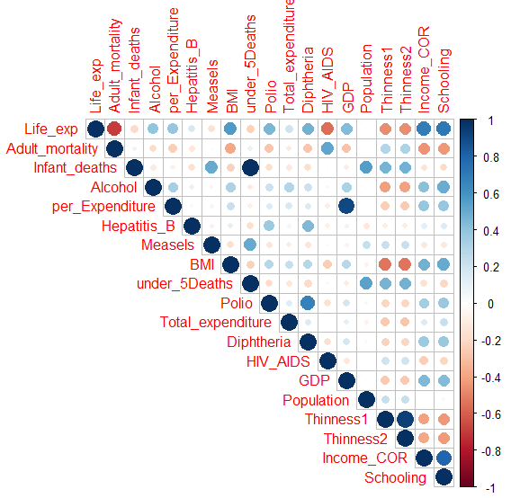
Correlation Plot
Infant deaths is highly correlated with under_5deaths
per_Expenditure is highly correlated with GDP
Let us remove under_5Deaths & per_Expenditure to ignore multi-collinearity

Slide 10
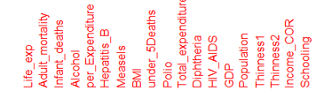
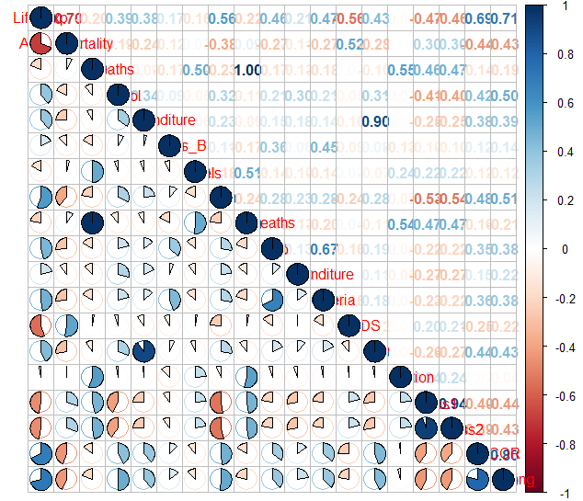

Slide 11
Data after cleaning
Status
Polio
Total Expenditure
Diphtheria
Adult Mortality
Infant Deaths
Alcohol
Hepatitis
Measles
BMI
HIV/AIDS
GDP
Thinness 1-19yrs
Thinness
5-9 years
Income
COR
Schooling
Country
Life Expectancy
Year

Slide 12

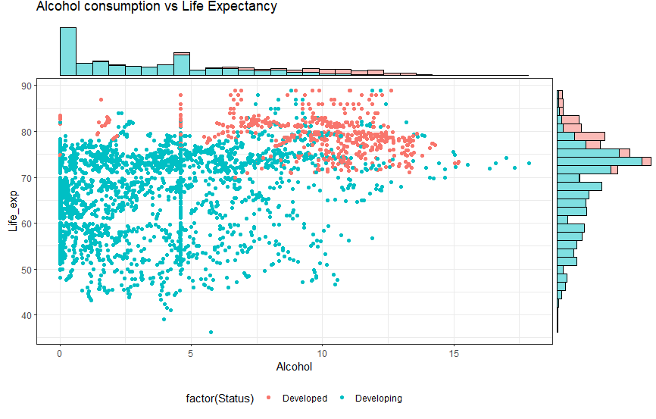
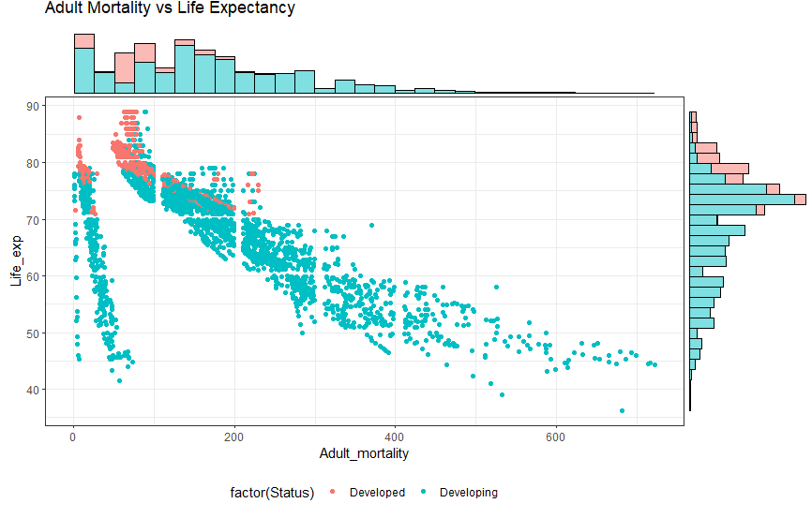
Data Visualization

Slide 13
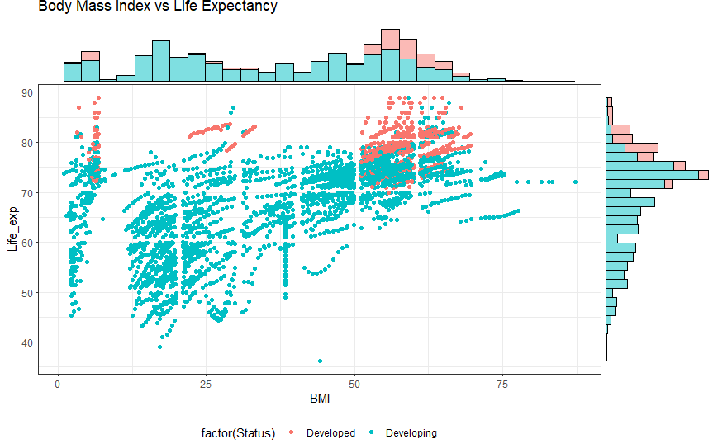
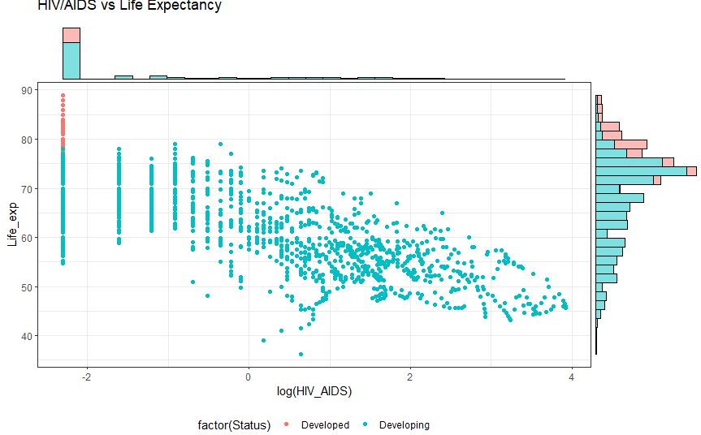

Slide 14
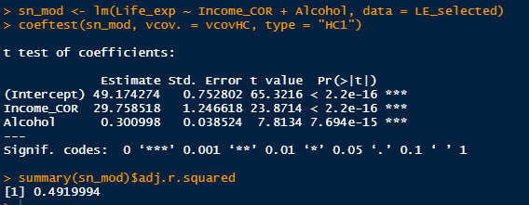
Models
This model shows positive coefficient for Alcohol

Slide 15
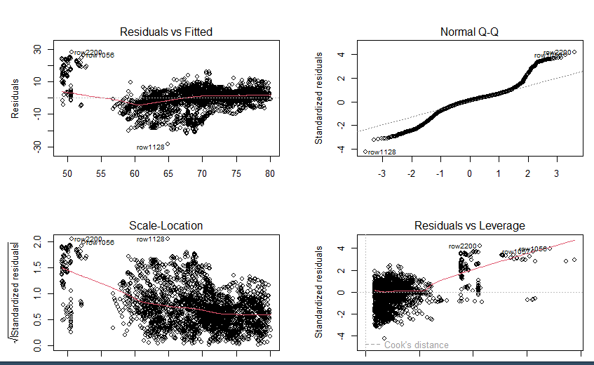

Slide 16
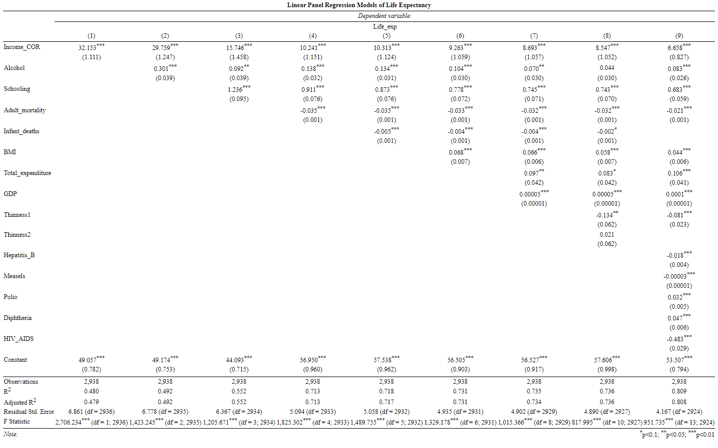

Slide 17
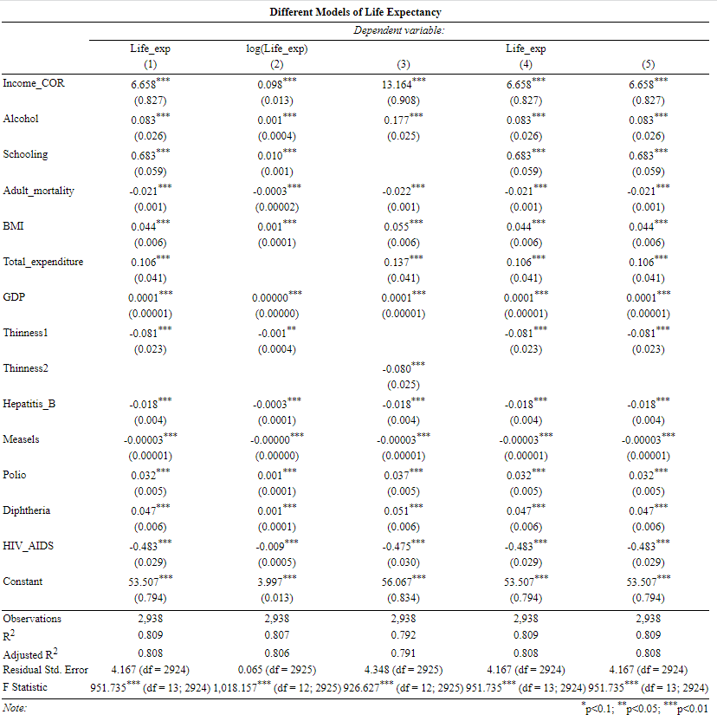

Slide 18
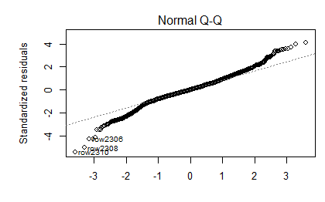
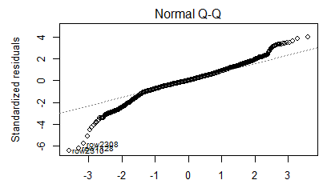
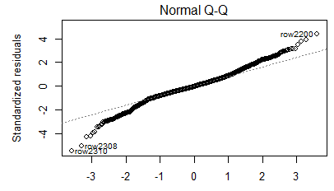
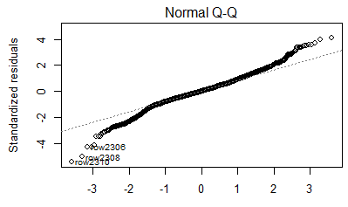
Linear
Linear log
Quadratic
Cubic

Slide 19
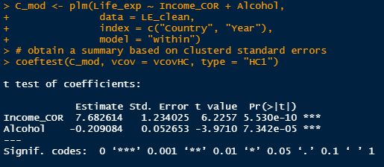
Panel Data Models
*This model shows negative coefficient for Alcohol

Slide 20
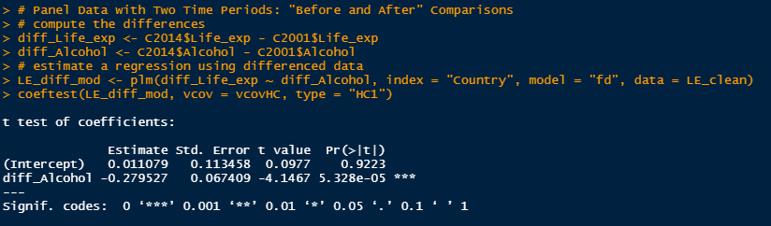
Difference in time periods

Slide 21
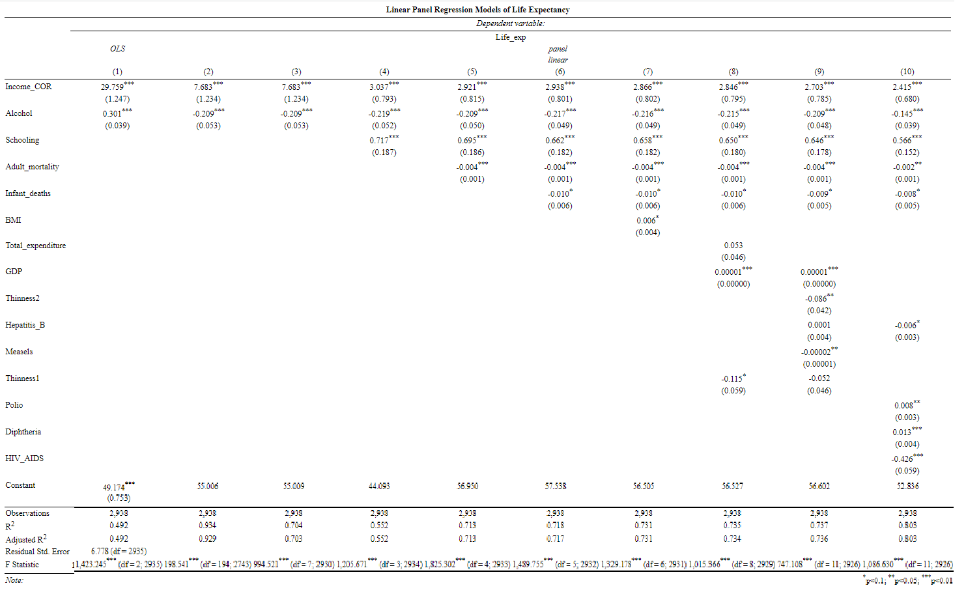

Slide 22
Results
Y_{it} = β₁X_{1it} + β1X1_{it} ⋯ + β_{k}X_{kit} + α_{i} + u_{it}
Life_exp = 52.836 + 2.415(Income_COR) – 0.145(Alcohol) + 0.566(Schooling) – 0.002(Adult_Mortality) – 0.008(BMI) - 0.006(Hepatitis_B) + 0.008(Polio) + 0.013(Diphtheria) - 0.426(HIV_AIDS)
Interpretation of Results:
Holding all factors fixed, a 1% increase in IncomeCOR in a country is associated with an increase in Life Expectancy by 880 days on average
Holding all factors fixed, a 1% increase in Alcohol in a country is associated with a decrease in Life Expectancy by 51 days on average
Hypothesis:
The P-value is 0.0003864, which is smaller than the significance level 0.05. Thus we can reject the null hypothesis that at least there is no relationship between Life Expectancy and the independent variables. We conclude that there is a relationship between the variables and that model is statistically significant.

Slide 23

Conclusion
The Data is accurate as it came from WHO but it contains many outliers which were significant which affected the better fit of the model
There is a problem with skewness and we couldn’t solve it by applying log or sqrt or inverse functions
There are other factors like accidents, pollution, stress, etc. that might have an impact on life expectancy (future research)
How effective the model can be if we consider countries categorized by their wealth with a fixed effects model? (future research)

Slide 24
References
https://equityhealthj.biomedcentral.com/articles/10.1186/s12939-020-01315-z
https://www.thelancet.com/journals/lancet/article/PIIS0140-6736(18)31694-5/fulltext
https://ourworldindata.org/life-expectancy
https://genus.springeropen.com/articles/10.1186/s41118-019-0071-0
https://towardsdatascience.com/how-different-factors-have-an-influence-on-your-life-expectancy-7b807b04f33e
https://www.researchgate.net/publication/299604336_Fixed_and_Random_effects_models_making_an_informed_choice
YouTube Channel Data Digest for R codes

